Slide 1
Assignment 1 group 6 Reversi
Malte Ewald
Henri Schaudinn
Frithjof Alms

Slide 2
Contents
Repository Setup
Server Connection
Data structures
Map creation

Slide 3
Repository Setup
Java as codebase
CI next assignment
Gradle buildscript
  Java Plugin
  Shadow Plugin

Slide 4
Server Connection
Java Socket and DataStreams
No busy waiting
Flexible parameters
Simple Handling

Slide 5
Data Structures
Current priorities
simplicity
"visual representation"
Future priorities
memory efficiency
fast to work with using Algorithms
"easily iterable"

Slide 6
Simple structure
Basic info(ex. Bombs) as integer
Map as Tile [][] matrix
Tile contains special transitions + Owner/type
myStones, opponentStones, relevantStones for Algorithms

Slide 7
Improvement Ideas
Swap Tile[][] to int [][] to save memory
PossibleMoves List for faster Algorithms
Maybe save move in deepsearch as delta instead of new matrix with a checkpoint all x moves

Slide 8
Map creation

Slide 9
Default Map Creation
Slow
Tedious
Easy to make mistakes
Hard to create large/complex maps

Slide 10


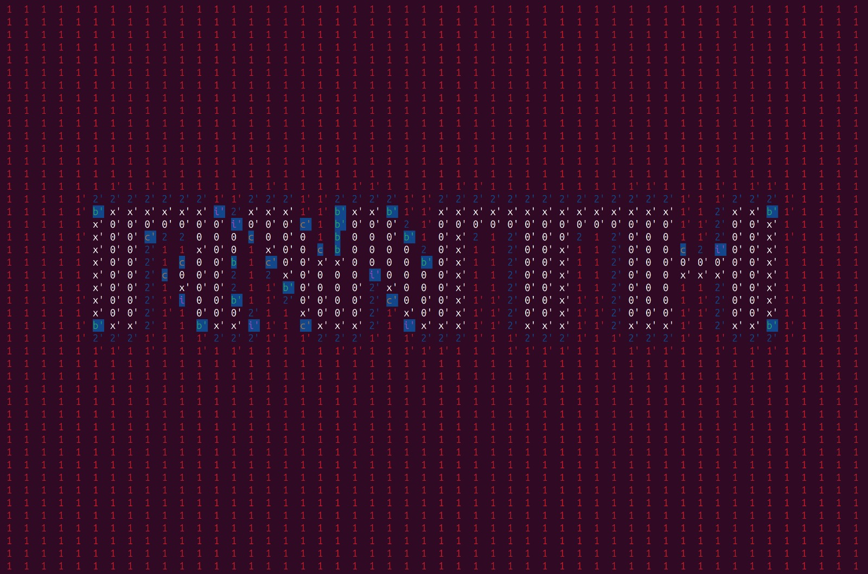
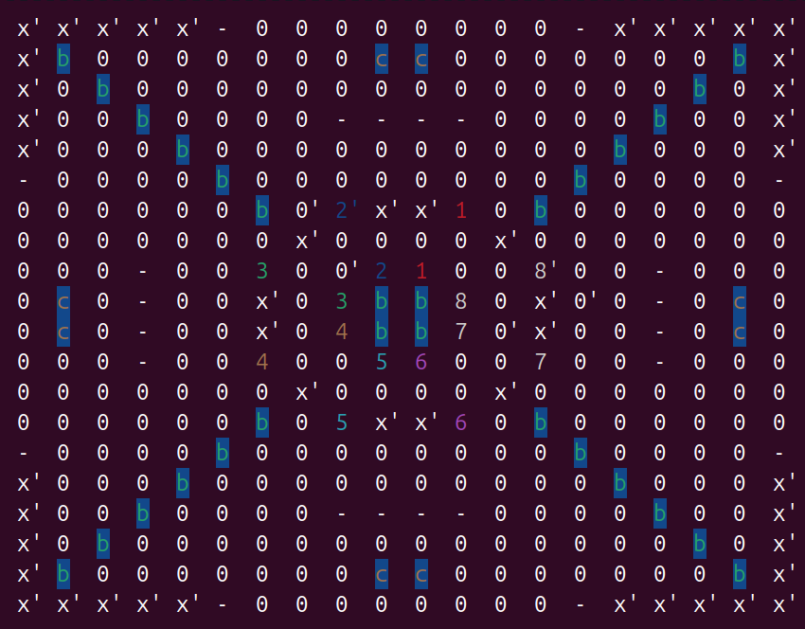
Map Generator
Using Python with pillow and numpy

Slide 11

How it works
Pillow
Algorithm
Image[][]

Slide 12
The Algorithm
How do you map 256 intensity values to a variable number of characters?
1. Solve mapping
- round values to the next „step“
2. Solve variability
- dynamically create „steps“ dependent on the number of players

Slide 13
Competitive map

